Slide 1

Attention Is All You Need
報告人 : 張立科

Slide 2
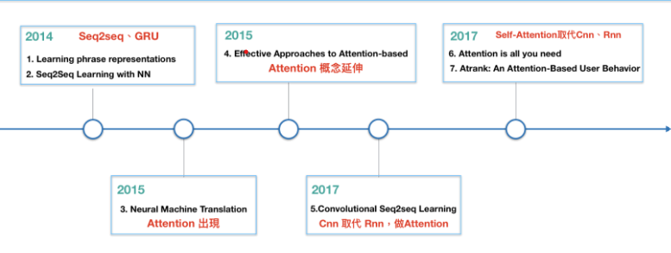
Outline
1.background knowledge
2.Introduction
3.Seq2Seq Model
4.Seq2Seq Model with attention
5.Transformer(Encode)
6.Transformer(Decode)
7.Conclusion

Slide 3
Reference
Dzmitry Bahdanau, KyungHyun Cho & Yoshua Bengio. NEURAL MACHINE TRANSLATION BY JOINTLY LEARNING TO ALIGN AND TRANSLATE. In ICLR , 2015
Jianpeng Cheng, Li Dong & Mirella Lapata. Long Short-Term Memory-Networks for Machine Reading. 2016
3.Vaswani et al. Attention Is All You Need. In NIPS,2017

Slide 4

background knowledge
1.CNN (Convoluational Neural Network )
2.RNN (Recurrent Neural Network)
3.Matrix multiplication of Linear algebra
4.Natural Language Processing
5.Encoder-Decoder ( Seq2Seq model）
圖一。Recurrent Neural Network

Slide 5
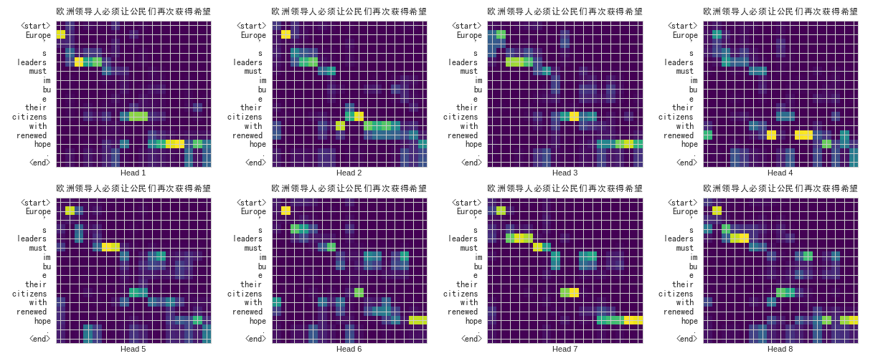
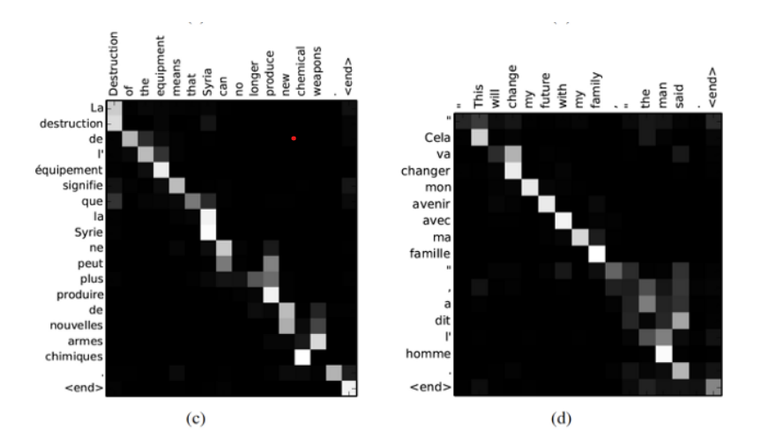
Introduction
Transformer (part of Attention) will "pay attention" to the input vocabulary that needs attention in the translation to generate the corresponding output words

Slide 6
Preprocessing
1.Tokenization
2.Data/Text processing (Dictionary、Vocabulary)
3.One-hot encoding (Traditional way)
3.Distributed representation: In NN,we call word embedding
(input words/Sentence and output vectors/Matrix)
4.Flatten

Slide 7
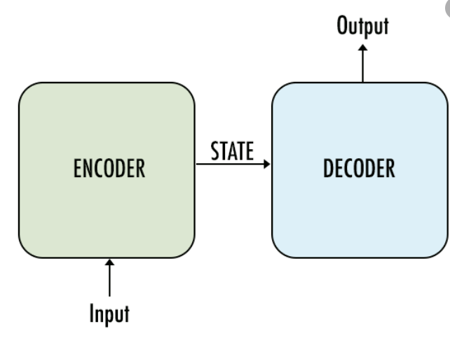

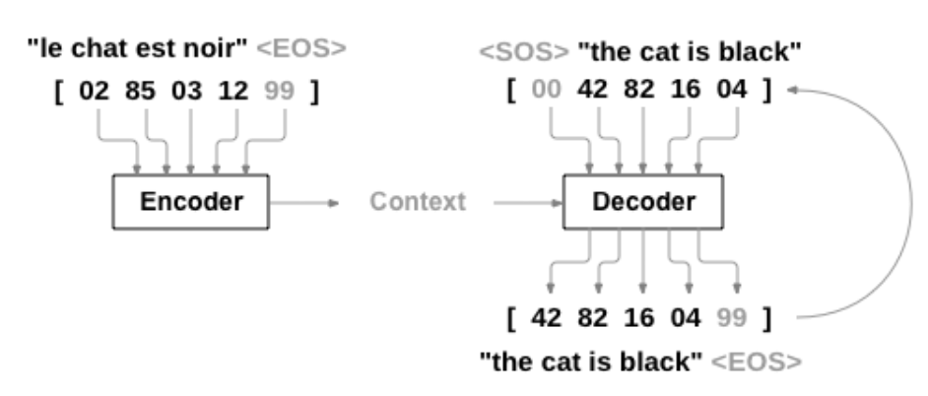
Seq2Seq Model

Slide 8
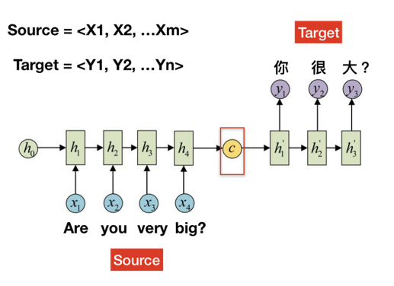
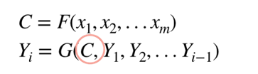
Seq2Seq Model
Formula

Slide 9
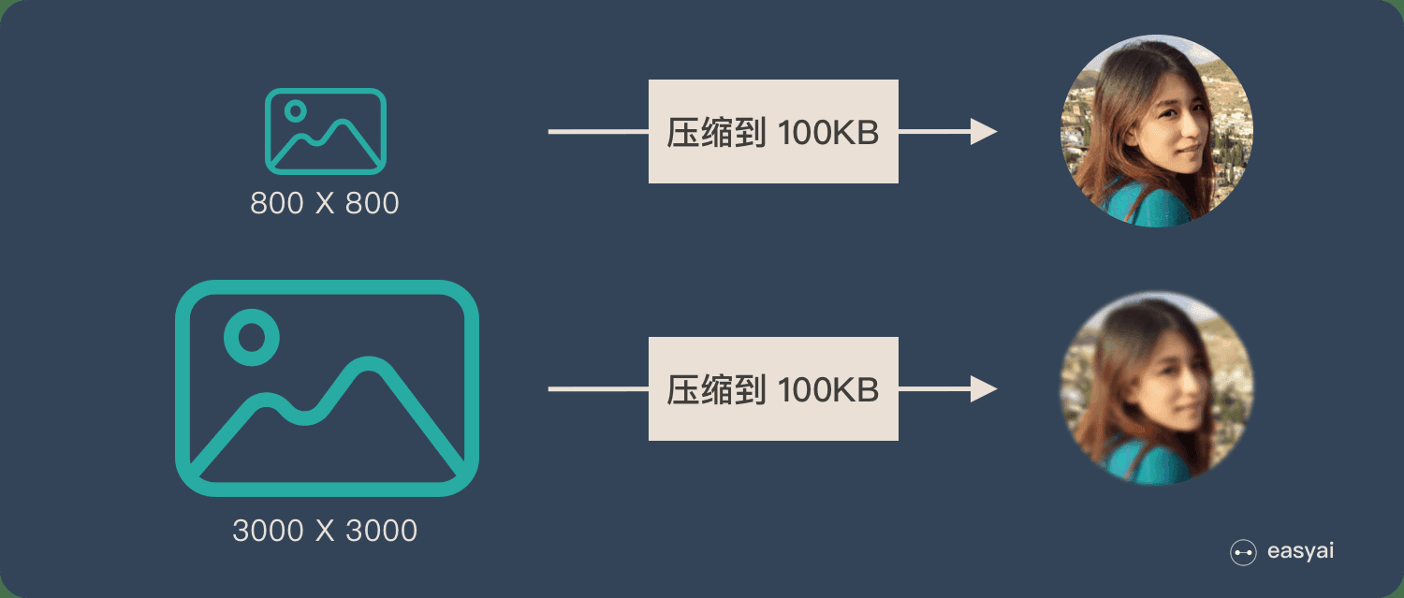
BUT…
Formula

Slide 10
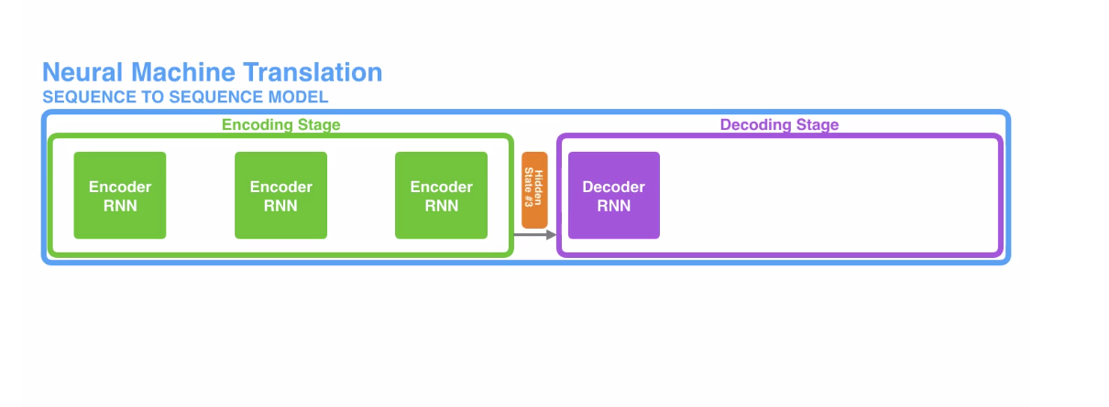
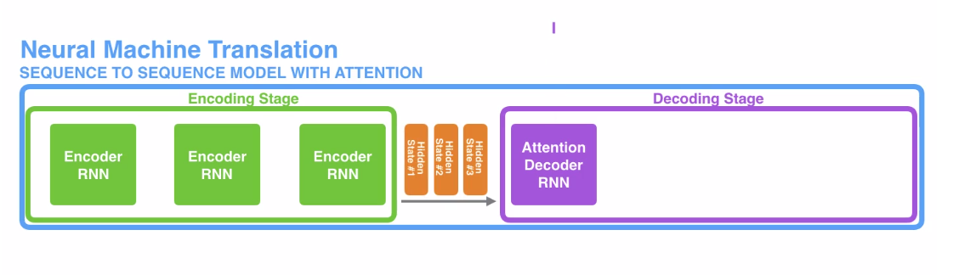
Seq2Seq Model with attention
seq2seq model
seq2seq model with attention

Slide 11
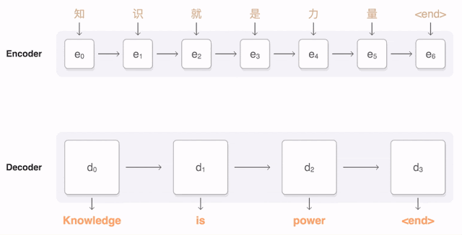
Seq2Seq Model with attention

Slide 12
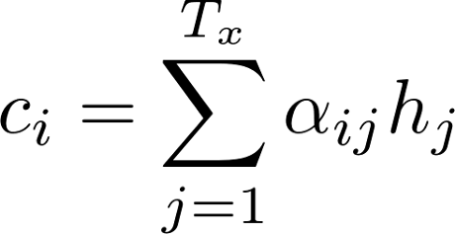
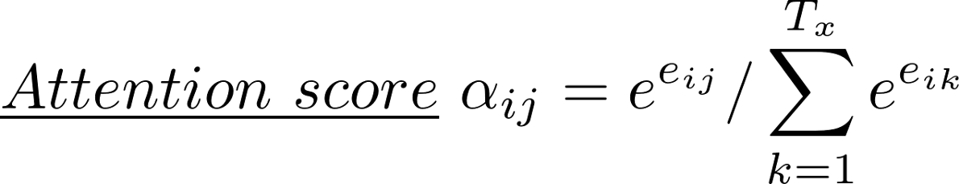
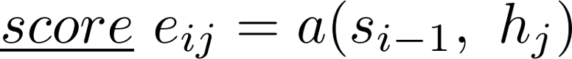
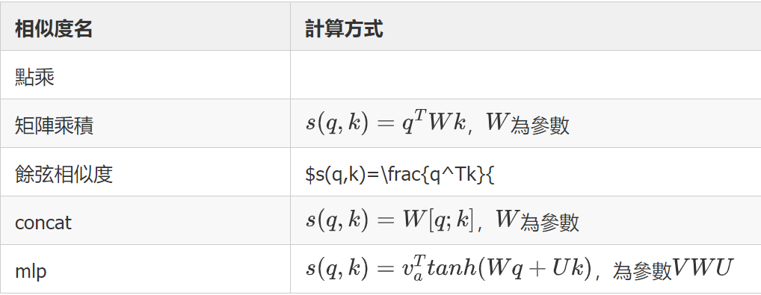
Seq2Seq Model with attention
Context vector

Slide 13
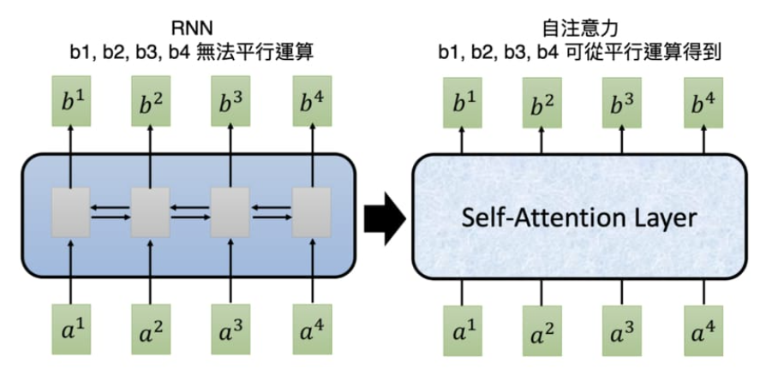
But…

Slide 14
Transformer
Query : refers to the sequence being queried.
Key : refers to the index being queried.
Value : the value of our feature itself.

Slide 15

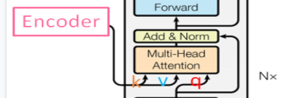
Transformer

Slide 16
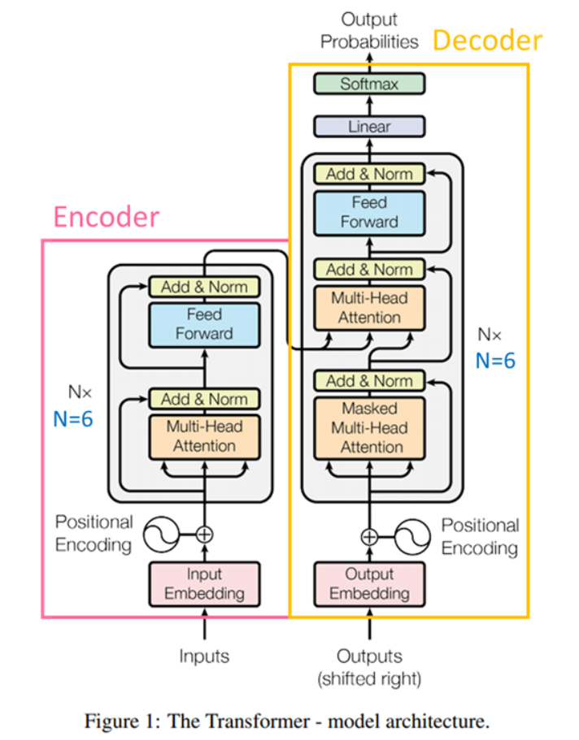
Transformer

Slide 17
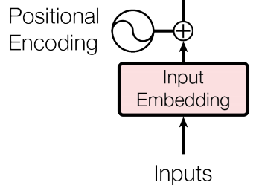
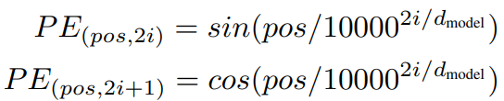
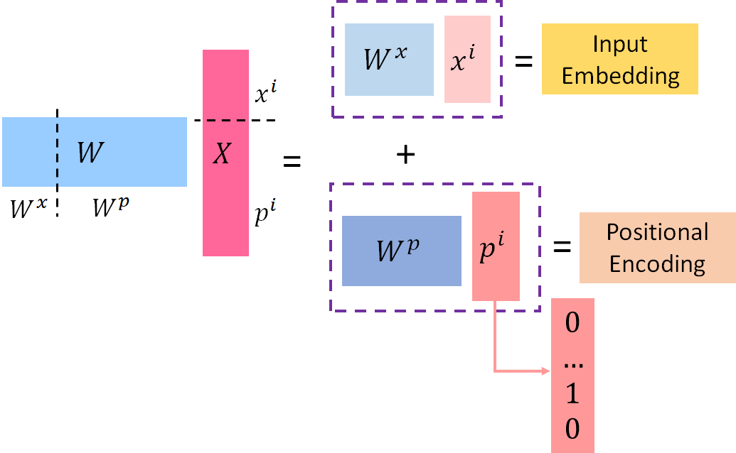
Transformer(Encode)_Positional Encoding

Slide 18
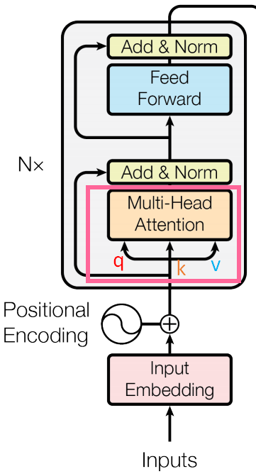
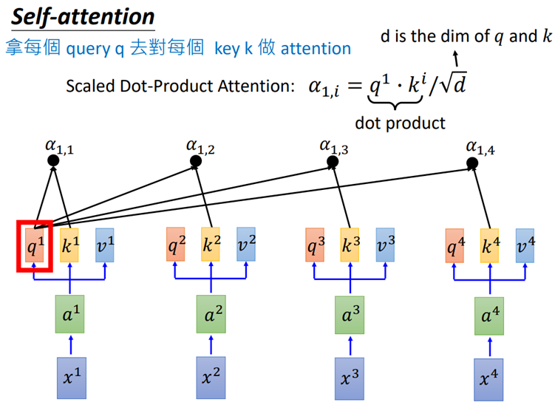
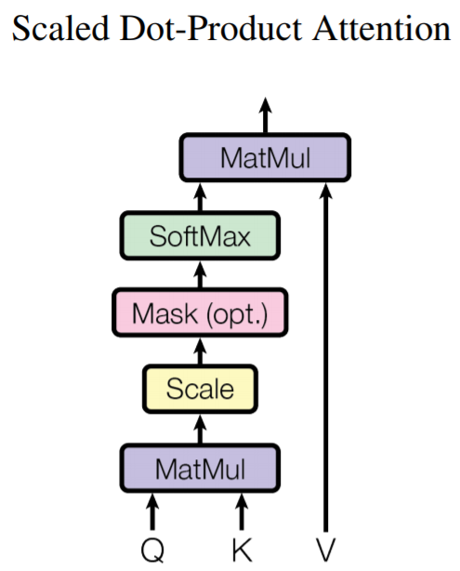
Transformer(Encode)_Multi-head Attention
圖解

Slide 19

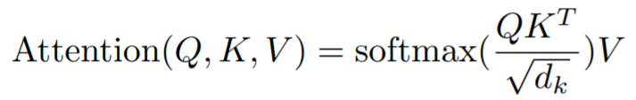
Transformer(Encode)_Multi-head Attention
數學公式

Slide 20
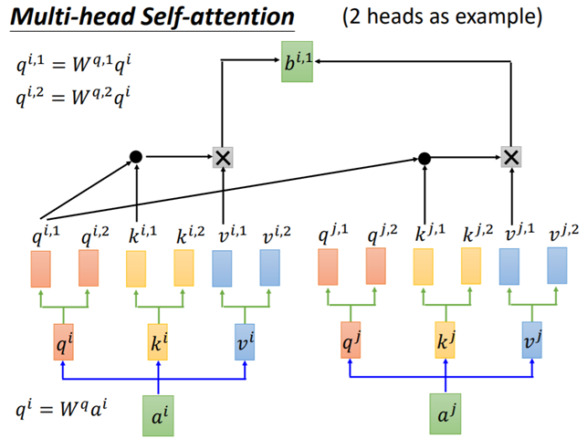
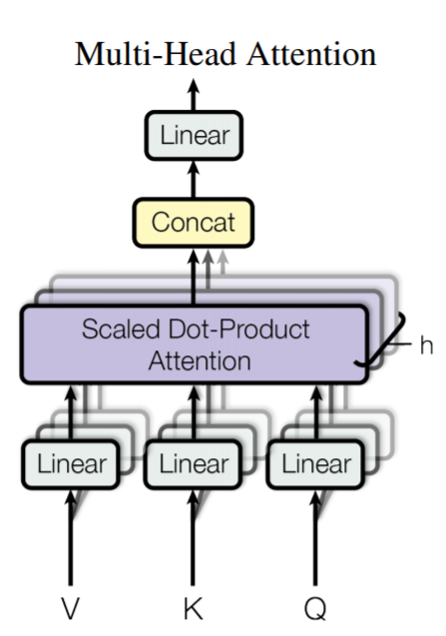
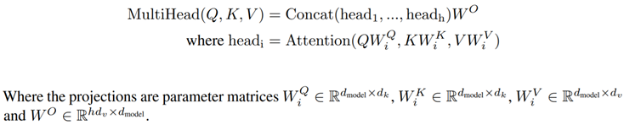
Transformer(Encode)_Multi-head Attention

Slide 21
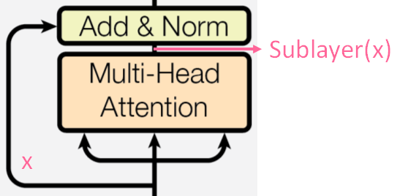
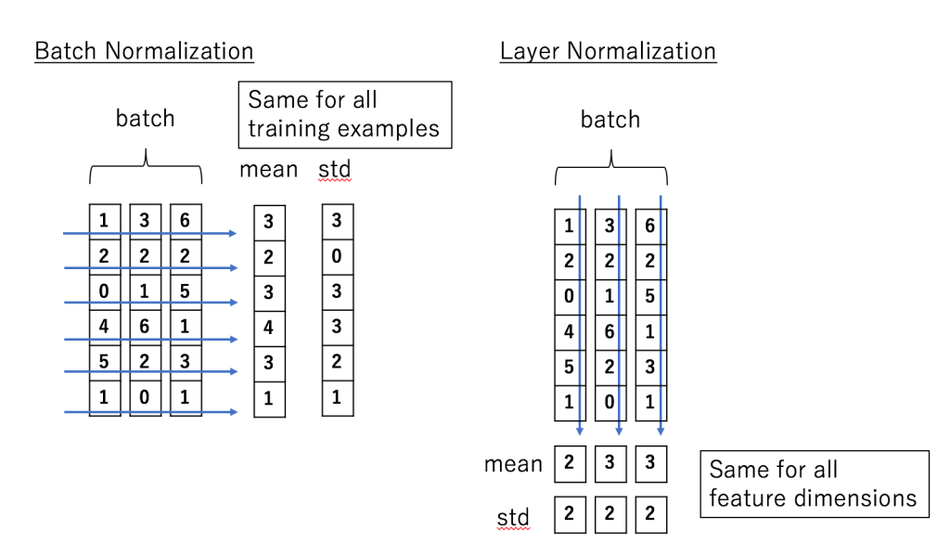
Transformer(Encode)_Add & Norm

Slide 22
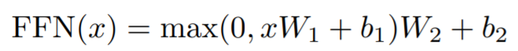
Transformer(Encode)_Position-wise Feed Forward

Slide 23
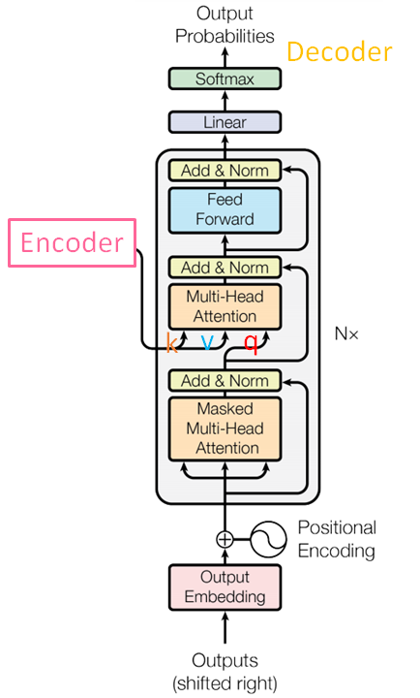

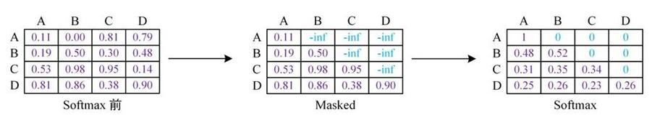
Transformer(Decode)_Masked Multi-head Attention

Slide 24

Conclusion

Slide 25
Thank you !

